Slide 1
EFFECT OF MUSIC ON PHYSICAL PERFORMANCE
Group 11
IE 4461
Ana Alvarado
Amber Ashton
Keneth Banegas
Ashtan Andrus
Julia Barkley

Slide 2
Table of Contents
Background
Objective
Hypothesis
Methods & Procedure
Results
Conclusions
Questions
References
Appendix: NIOSH

Slide 3
Background
Music is known to impact psychological and physiological states influencing individuals' capabilities and well-being.
A study conducted by the kinesiology faculty at the University of Split in 2020 displays the importance of employee well-being, including how music can be strategically employed to enhance focus, creativity, and overall job performance.
Research also explores the relationship between music tempo and perception of effort during physical activity, especially endurance. Music with higher tempo correlated with low Borg scale measures (Leisuk, 2005).

Slide 4
Objective
Assess whether listening to music significantly affects the number of lifts per minute to be completed during a 10-minute weightlifting task compared to a condition without music.
Explore how music with a fast tempo affects perceived fatigue/exertion during weightlifting tasks.

Slide 5
Hypothesis
NULL HYPOTHESIS : There is no significant difference in physical performance (lifts/min) between individuals who perform lifting activities accompanied by music and those who perform the activities in silence.
𝜇1 = 𝜇2
ALTERNATE HYPOTHESIS : There is a significant difference in physical performance (lifts/min) between individuals who perform lifting activities accompanied by music and those who perform the activities in silence
𝜇1 ≠ 𝜇2

Slide 6
Methods & Procedure
Pre and Post Questionnaire
Pre and Post – Lift questionaries are conducted to gather information on participant experience and supplement data collection.
Demographics & Perceived Exertion of Participants
No history of musculoskeletal injuries
Borg scale of exertion (6-20)
Age (19 to 27)
Height (cm): 148.5 to 180
Activity Level: Moderate to High
Song Selection
“Clarity” by Zedd
With Lyrics
Tempo 170 - 190 bmp (High)
Emotional Response

Slide 7
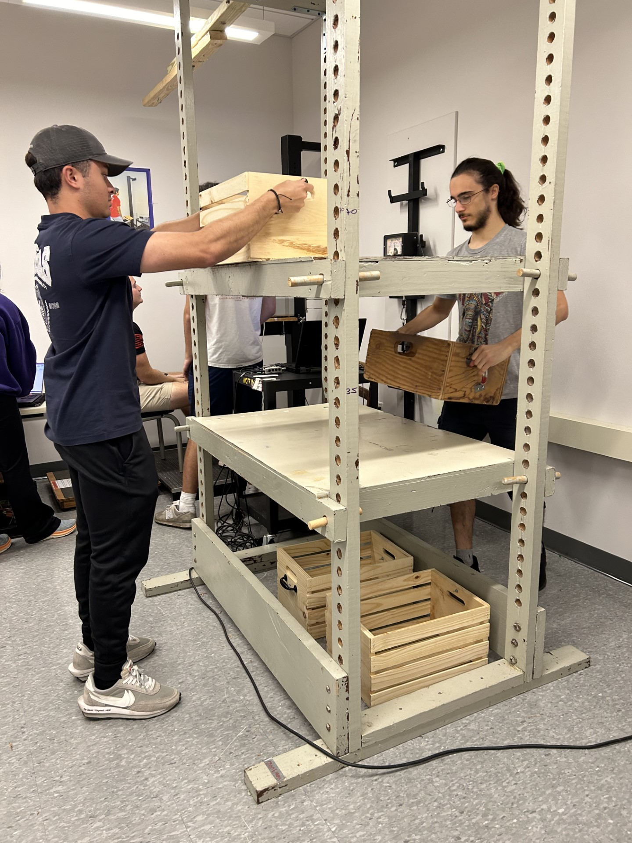
Experiment
Lift a box with handles set to 45 degrees.
combined weight of 8kg
Lift box from middle shelf to the top shelf for duration 10 mins, in silence.
Wait minimum of 24 hours of rest.
Participants repeat experiment while listening to “Clarity” by Zedd.
Pre and Post – Lift questionaries are conducted before and after lifts.

Slide 8
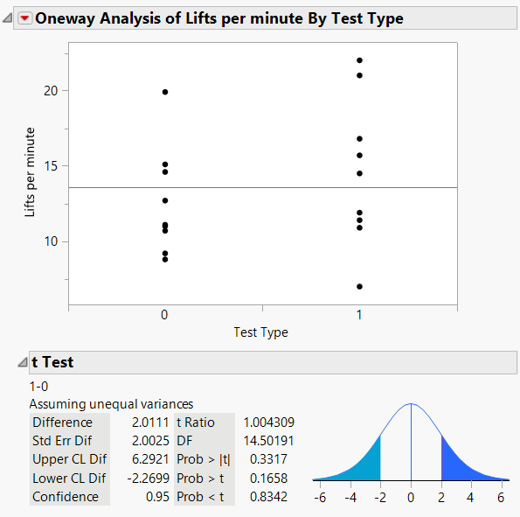
T-Test Lift Per Minute
Physical Results
P-Value = 0.3317 > 0.05 = α
Fail to reject the null hypothesis
No significant difference

Slide 9
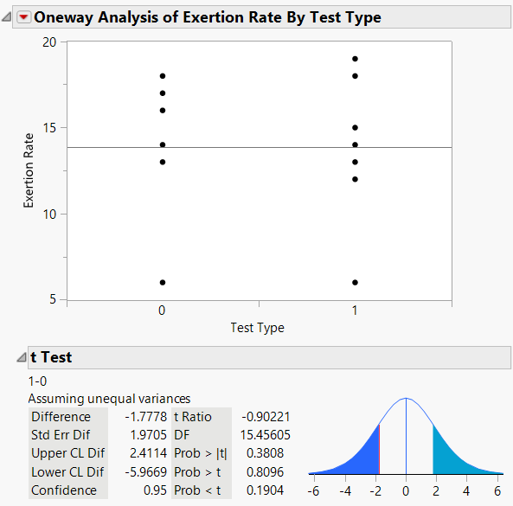
T-Test for Exertion
EXERTION RESULTS
P-Value = 0.3808 > 0.05 = α
Fail to reject the null hypothesis
No significant difference

Slide 10
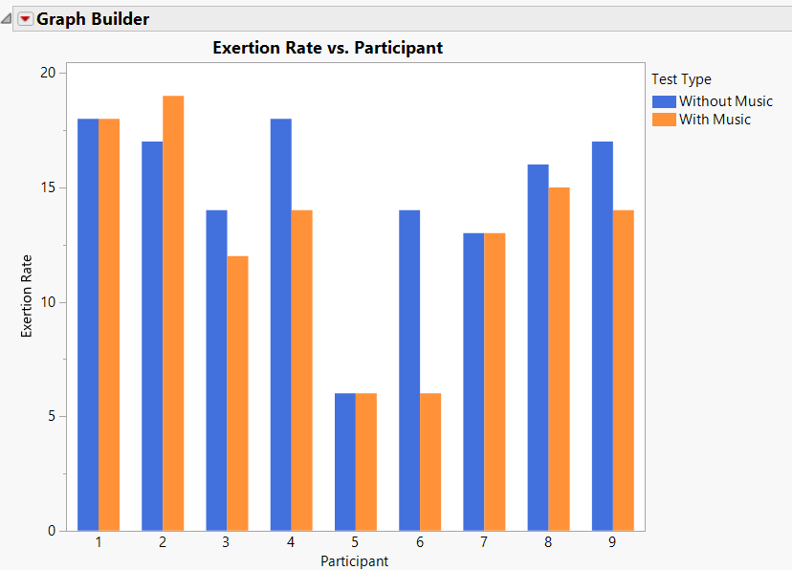
Exertion Results
Borg scale of perceived exertion (6-20)
 | Without Music (Lifts/Min) | With music (Lifts/Min)
Mean | 14.8 | 13
Std Dev | 3.8 | 4.5

Slide 11
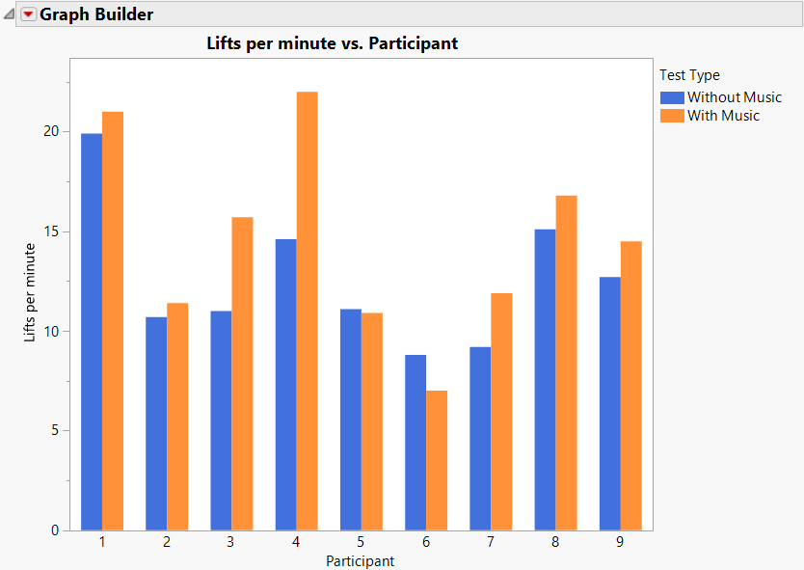
LIFTS PER MINUTE RESULTS
Lifts per minute generally increases with music versus without.
 | Without Music (Lifts/Min) | With music (Lifts/Min)
Mean | 12.57 | 14.58
Std Dev | 3.5 | 4.88

Slide 12
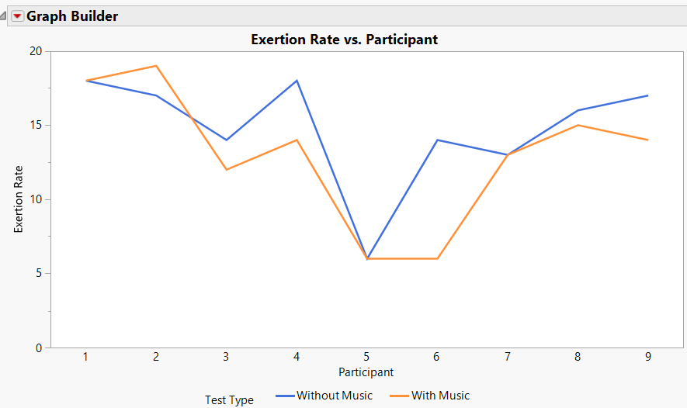
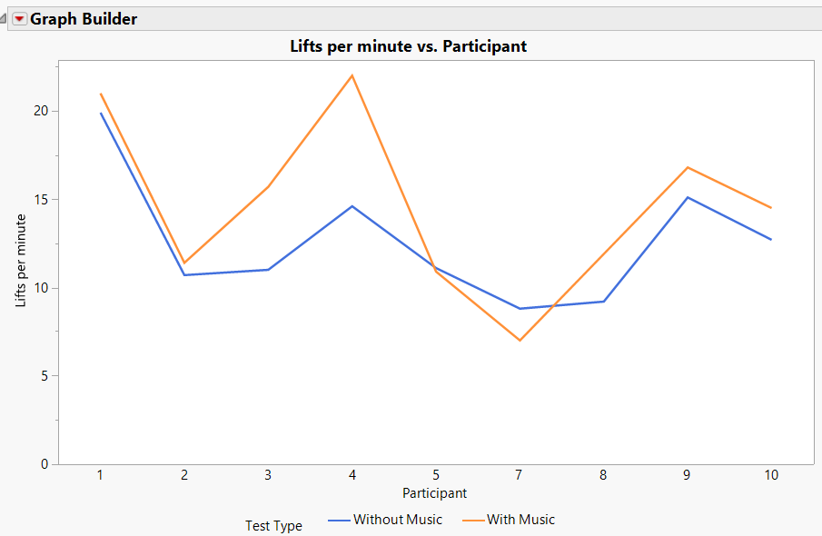
Results
 | Means with Music | Means Without Music | Difference | Percent Difference
Lifts Per Minute | 14.58 | 12.57 | 0.22 | 16.0%
Exertion | 13 | 14.8 | 0.43 | 13.8%
Notes:
Explain Calculation

Slide 13
Conclusion
Based on a study from the National Academy of Science from 2013, the inclusion of music is likely to result in an increased number of tasks successfully completed within a certain time limit, which is confirmed by our statistical analysis.
Inverse relationship between perceived exertion and lifts per minute
Improvements
Standardize process
Increase the number of participants
Reduce lift time
Limitations
Heights of participants
Setting (warehouse vs. classroom)
Controlled area; little to no sound effects
Safety: Audio Level

Slide 14
References

Slide 15
Questions?

Slide 16
PERCENT DIFFERENCE CALCULATIONS
$${Percent Diff}_{LPM}= \left(\frac{{Avg}_{W}−{Avg}_{W/O}}{{Avg}_{W/O}}\right)∗100$$
$${Percent Diff}_{LPM}= \left(\frac{14.6−12.6}{12.6}\right)∗100= 16.0\%$$
Calculation for Lifts Per Minute
$${Percent Diff}_{E.R}= \left(\frac{{Avg}_{W/O}−{Avg}_{W}}{{Avg}_{W}}\right)∗100$$
$${Percent Diff}_{E.R}= \left(\frac{14.8−13}{13}\right)∗100=13.7\%$$
Calculations for Exertion Rate

Slide 17
NIOSH
Task Variables | Representation | Measurement
Weight of the box | W | 8 kg
Load constant | LC | 23 kg
Vertical height from floor to shelf | V | 86.36 cm
Distance object is moved horizontally | H | 50.8 cm
Frequency and duration of activity | F | 10 mins
Distance the object is moved vertically | D | 60.96 cm
Grip quality | C | Fair
Asymmetry | A | 0 degrees
RWL = 367.8 kg
LI = 0.0217
LI ≤ 1 therefore Acceptable
Note: this value is only a reference since the frequency of lifts varies by individual.

