Slide 1
Advanced Manufacturing and Machining Facility
By Amber Ashton, Amelie Echeverria, and Kendal Frazier

Slide 2
Background and Objectives
Offers extensive suite of manufacturing and fabrication services to:
Students
Researchers
Other campus departments
Wider Community
Services Include :
Computer Numerical Control (CNC) Machining
Electric Discharge Machining (EDM)
Welding
Large-Format Waterjet Cutting
Additive Manufacturing Processes
The Advanced Manufacturing and Machining Facility (AMMF)

Slide 3
Problem Statement
Unpredictable Customer Arrivals: Random intervals and varying project requirements disrupt workflow predictability.
Inconsistent Initial Screening: Project feasibility assessments often lead to unclear outcomes, causing delays or additional visits.
Ambiguous Prioritization Rules: Lack of clear guidelines for ranking projects (e.g., student vs. research vs. external) results in inefficiency.
Queue Management Issues: "First-come, first-served" rule often overridden by project complexity or client type, causing inconsistent wait times.
Extended Flowtimes: Longer processing times and delays impact customer satisfaction and retention.
The current workflow is disrupted by inconsistent initial screening, ambiguous prioritization rules, queue management issues, and extended flowtimes, leading to delays, inefficiencies, and reduced customer satisfaction.

Slide 4
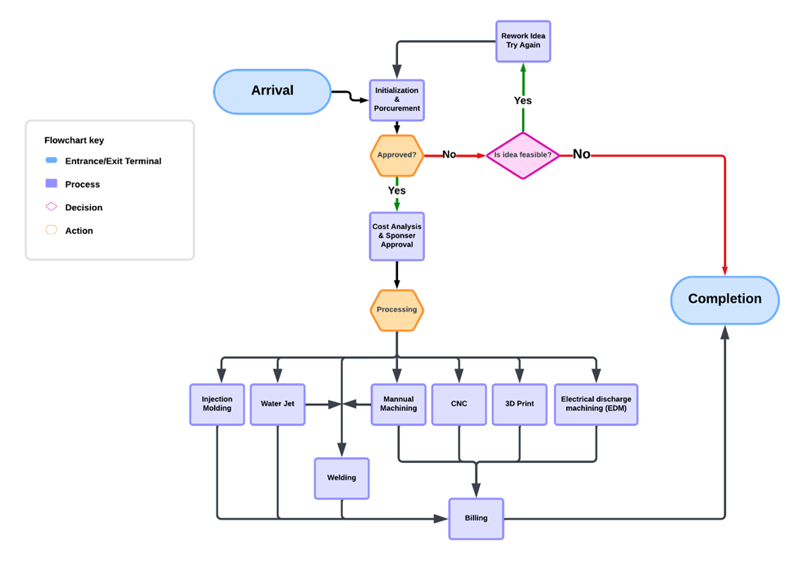
Conceptual Model

Slide 5
Lean Alternative
Proposed alternative:
Priority-based queuing system.
Increased capacity (additional machines and staff).
Reduced approval and payment deadlines.
Lean principles
Value Stream Mapping & Continuous Flow
Eliminate Waste & Optimize Resources
Kaizen

Slide 6
Data Collection
EDM | 3.25, 17.5, 1.5, 5, 12, 10, 4
Machining | 1, 5, 11.5, 4, 14.75, 2.25, 4.5, 13, 9, 3.5, 17.75, 2.5, 2.5,1,5,1, 13.5, 3,1,2, 1,1,19.5, 1, 7.5, 1.5, 90
Waterjet | 3.5, 3, 2.5, 1,2,1,0.5
Welding | 1,1.5,1,1,0.5
Historical Data Set of Various Processing Times
Data Collected:
Historical service times for EDM, machining, waterjet, and welding processes.
Customer types: Bio & Ag, Capstone, Research, Other, etc.
Processing steps: procurement, approval, manufacturing, and final billing.
Data was used to create parameters used in Simio modeling.
Distributions were hypothesized and tested using JMP statistical analysis
Challenges within Data:
Small sample sizes led to limitations in rejecting certain distributions.
Variability in data (e.g., customer arrivals and documentation errors).

Slide 7
Input Analysis
Histograms based on Historical Data:
Distributions were analyzed using a Goodness-of-Fit Test
Results were used to determine expressions for processing times
For Machining Lognormal distribution was used with the processing time expression determined as Random.Lognormal(1.37,1.17)
For Waterjet Weibull distribution was used with the processing time expression determined as Random.Weibull(1.93,2.18)
Green Line: Normal distribution fit
Blue Line: Lognormal Distribution fit
Orange Line: Weibull Fit

Slide 8
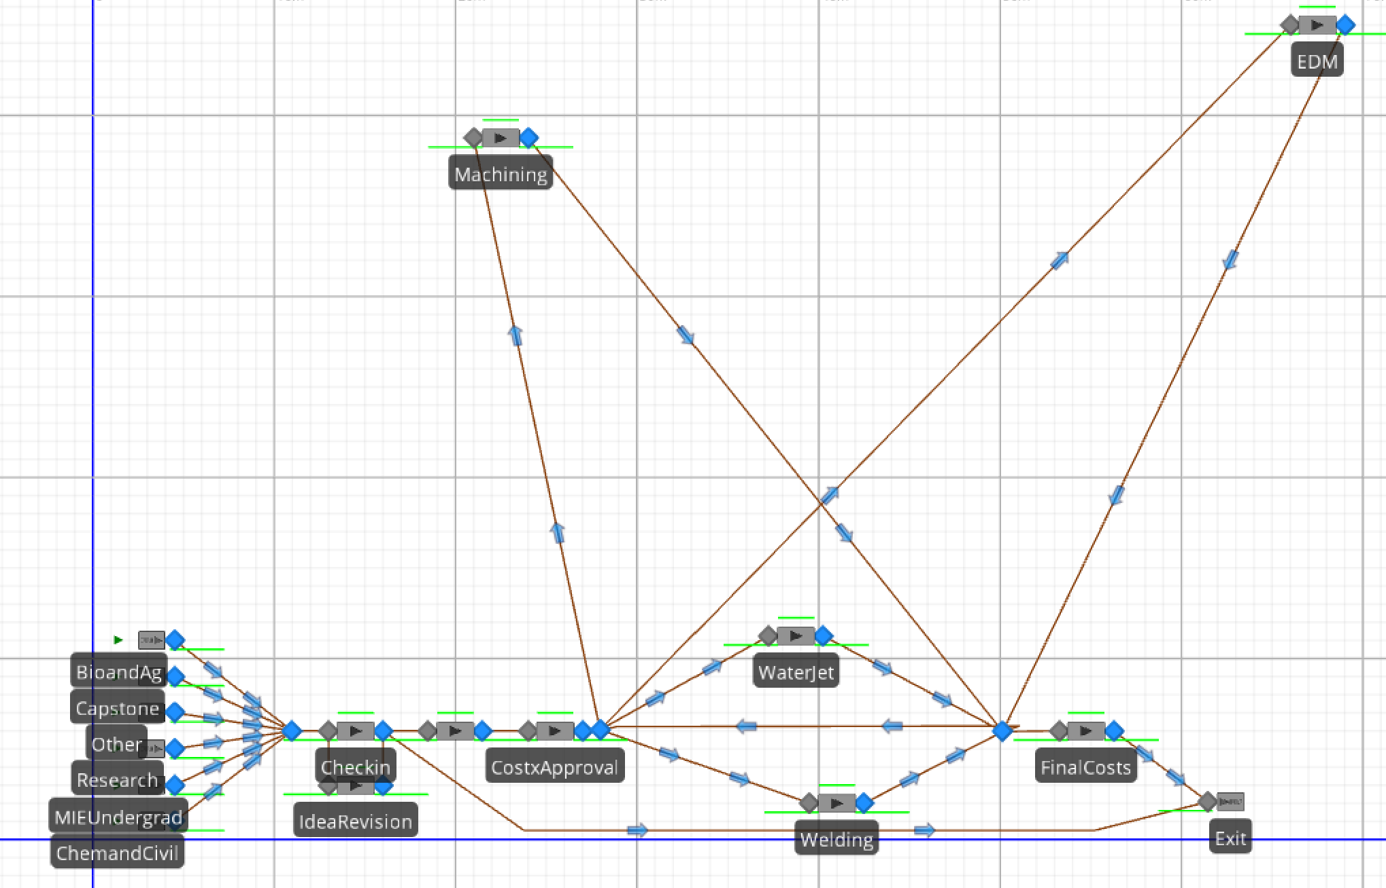
Simulation Model Current Process

Slide 9
Simulation Model For Alternative
Increased Machine Capacities
Closer Machine Locations
Increased Worker Capacity

Slide 10
Experiments & Output Analysis
Response | Mean Difference | Upper Percentile Difference | Lower Percentile Difference
RE | 1207.75 | 1153.74 | 1280.73
MIE | 1142.07 | 1282.74 | 1055.41
CnC | 1067.48 | 1145.01 | 1187.36
Cap | 1317.93 | 1329.42 | 1301.47
BnA | 1203.09 | 1072.51 | 1267.31
ChemandCivil | 1067.48 | 1145.01 | 1187.36
MIEUndergrad | 1142.07 | 1282.74 | 1055.41
Research | 1207.75 | 1153.74 | 1280.73
Other | N/A | 908.49 | 846.54
Capstone | 1317.93 | 1329.42 | 1301.47
BioandAg | 1203.09 | 1072.51 | 1267.31
Experiment
10 replications
95% Confidence Interval
Terminating System
Run Length of 15 Weeks
Output Analysis
Subtracted alternative’s means, upper percentiles and lower percentiles from the current values
Smaller means in alternative => smaller flowtimes
Smaller CI in alternative mean reduced variability

Slide 11
Results
The alternative model demonstrates overall performance improvements, with reduced mean flow times for both customer processing and machining, driven by increased capacity and machine availability.
Flow Time Improvement: The alternative scenario demonstrates shorter average flow times compared to the current scenario, reflecting improved efficiency and operational performance.
Reduced Delays Across Response Types: The alternative scenario shows lower delays at both the slowest and fastest ends of the processing spectrum, enhancing system throughput and reliability.
Statistically Significant Findings: The analysis revealed that only "Capstone" and "Final Costs" showed significant differences between the current and alternative processes, indicating meaningful changes in these areas.
No Significant Changes in Other Categories: Categories such as Bio and Ag, Chem and Civil, MIE Undergrad, Waterjet, Machining, Procurement, EDM, and Welding showed no significant differences, suggesting the observed variations are random.
Operational Insights and Strategic Recommendations: The findings highlight opportunities to optimize bottlenecks like procurement and final costs by implementing priority-based queuing and increasing workstation capacity, improving system flow and efficiency.

Slide 12
Challenges and Learning Experiences
Challenges Faced:
Negative Processing Times in Initial Simulations:
Using Normal distributions for processing times resulted in unrealistic negative values.
Resolved by switching to Lognormal and Weibull distributions for better fit and accuracy.
Small Sample Sizes:
Limited historical data made it difficult to validate distribution fits and ensure accuracy.
Debugging the Simulation Models:
Initial errors in logic (e.g., incorrect flow loops) caused unrealistic outputs.
Iterative testing and SME feedback were critical for corrections.
Balancing Prioritization and Fairness:
Prioritizing critical projects improved flowtime for high-priority tasks but delayed low-priority ones.
Learning Experiences:
Simulation Modeling:
Learned the importance of selecting appropriate distributions to avoid unrealistic outputs.
Data Analysis:
Realized the need for larger datasets to improve input accuracy and reliability.

Slide 13
Conclusions & Recommendations
Significant improvements in flowtime and customer satisfaction.
Validation of lean principles through simulation modeling.
Recommendations for AMMF:
Implement capacity expansion for staff and machinines.
Regularly evaluate process performance to refine priorities.

