Slide 1
Labs 6 : Workstation Design
Group E – Cab Assembly
Amber Ashton
Mark Hanna
Bryson Martin

Slide 2
Purpose
Lab 6 aims to evaluate and improve the suitability of a current workstation, while also considering productivity, safety and well-being of workers.
Notes:
The objective of Lab 6 is to assess the suitability of our current workstation for online classes and enhance it to maximize productivity, safety, and well-being. The lab aims to apply the principles of workplace design and environment to evaluate and enhance home workspace. The optimization of a workstation is of utmost significance as workers often spend long hours working. Prolonged work hours in an inefficient workspace can lead to injuries, substandard work, and dissatisfaction among workers. In the actual work scenario, optimizing the workspace is crucial, particularly for engineers who spend long hours sitting to perform calculations or write reports. An optimized workspace assists workers in working for extended periods without jeopardizing their health and safety.

Slide 3
Tabulation
Element | Description | Quantity
DO23 | Yellow plastic walls used to support sides of cab; this is the primary foundationally support. | 2
A551(0051B) | Black metal forked plate with holes, functions as roof of the cab. | 1
D040 | Black plastic spacer with three holes that function to support the body of the cab. | 3
C769 | Larger black metal bracket with 7 holes used to hold up the front of the cab roof. | 2
C768 | Smaller black metal bracket with 5 holes used to support back left side of roof. | 1
A416(02365) | Small gray metal bracket with three holes used to support back right side of roof. | 1
A548(0048E) | Yellow metal forked bracket used support the front of the cab. | 3
A337(0037A) | Small metal square nuts with tapped through hole used to secure the screws. | 17
A637(0037B) | 5,8-millimeter (15/64 inch) screw | 6
A511(0111C) | 9,5-millimeter (3/8 inch) screw | 5
A411(0111A) | 12 mm (1/2 inch) screw | 4
A611(0111D) | 28-millimeter ( 1 1/8 inch) screw | 1
C994 | Metal screwdriver with red plastic handle used to tighten and secure bolts. | 1
C993 | Metal wrench used to hold square nuts and supplement securing screws. | 1

Slide 4
Workstation Design Materials
Element | Description | Quantity
Clear plastic trays | small plastic 2.5-inch x 3.75-inch tray aligned together offset 18 inches from left and 12 inches from the bottom table | 4
Yellow plastic trays | medium plastic 5.25-inch x 4.5-inch tray aligned together set 12 inches from left and 16 inches from bottom of desk | 5
Blue metal tray | 12inch x 6-inch metal tray aligned to bottom of desk centered to user preference, optimally set about 17 inches form left edge | 1
desk top computer | Standard Pc including screen, mouse, and keyboard; monitor angled approximately 45 degrees or optimal for operator | 1
laptop computer | Standard Laptop with screen, keyboard, and derive to scroll centered along upper railing measurement varies on laptop size | 1
footrest | 45-inch x 34 in adjustable foot tray set to 45 degrees set 20 inches from chair | 1
adjustable chair | chair set to 23 inches high with the back 14 inches from the desk | 1
adjustable desk | adjustable tabletop set to 31.5 inches high 47.4 inches wide and 29.5 long inches wide | 1

Slide 5
Lab Sketches

Slide 6
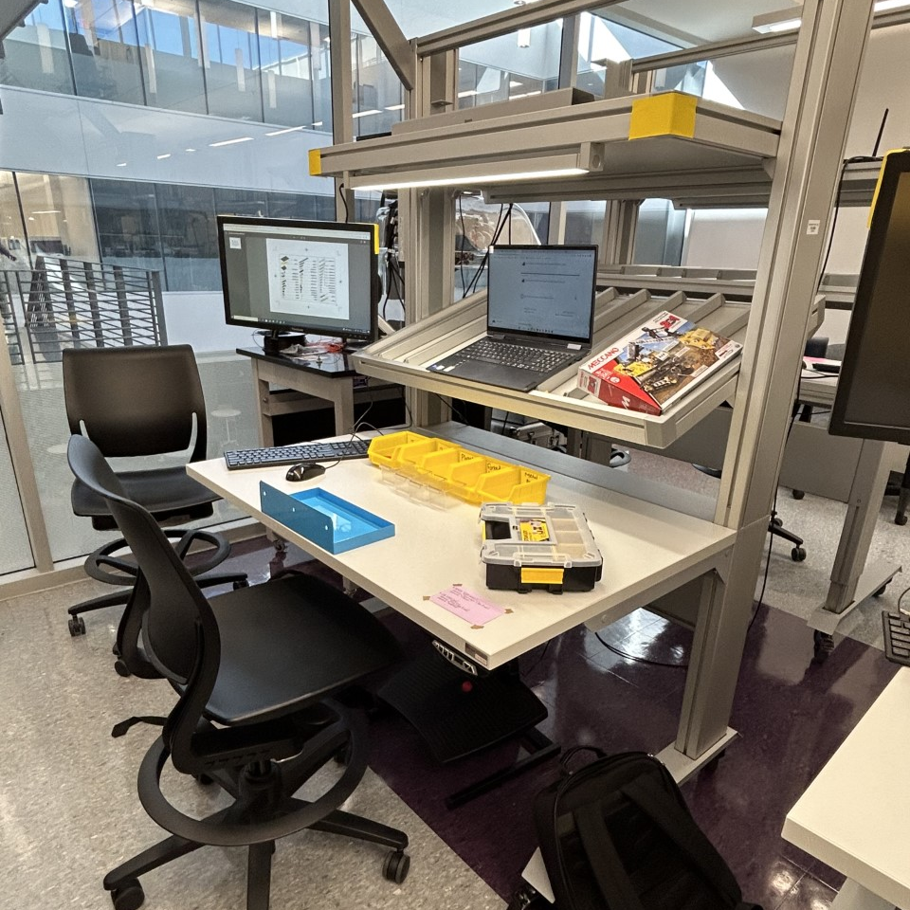
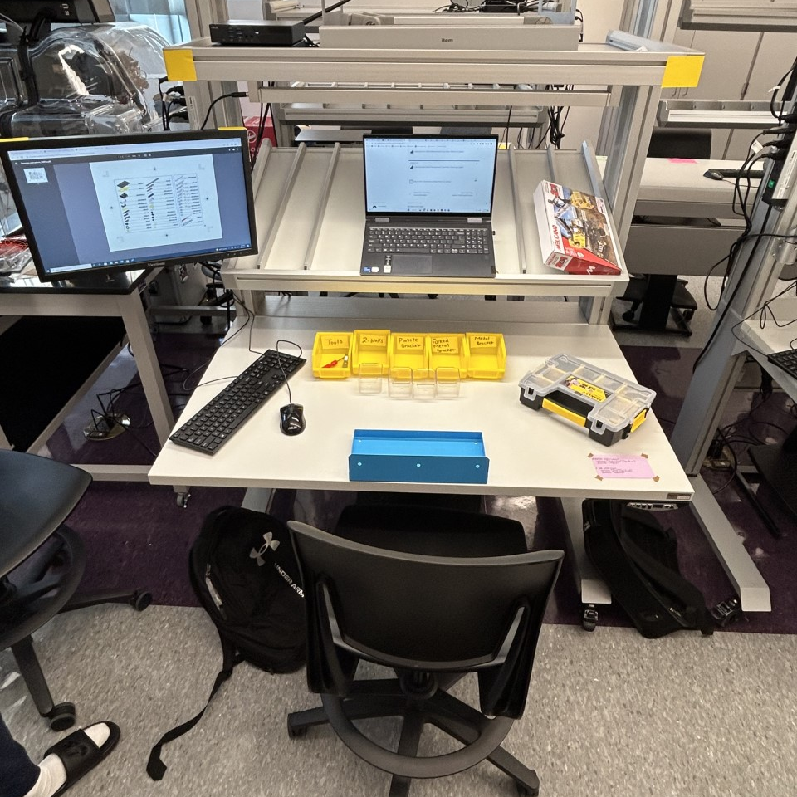
Layout

Slide 8
Justification
Element | Description | Principle of Work Design
Blue Metal Tray | A utilized way of catching fallen pieces. Reducing time-wastage. | Increases productivity & shortens motion's distances.
Yellow Plastic Trays | Trays used to organize & store different larger pieces separately. | Pre-assembled trays makes motion easier and increases productivity.
Adjustable Desk | A mechanism that allows the user to adjust to the optimal desk height. | Promotes safety from awkward positions thus reducing injuries.
Foot-Rest | Designed to elevate & support a person's feet when sitting. | Promotes comfort and reduces fatigue when sitting.
Desktop Computer | Utilizes space and gives you a better angle to visualize the workstation design. | Increases productivity thus making motion easier.
Adjustable Chair | Designed to fit the individual user's needs with features like adjustable height and seat depth. | Supports good posture and reduce risk of back injuries.
Clear Plastic Trays | Trays used to organize smaller parts necessary to build the cab that are needed in larger quantities. | Pre-organized trays eliminates any time wastage thus increasing speed of work.
Laptop Computer | Used to show the pictorial instructions for building the cab. | Maximizes efficiency in terms of pre-setting up the instructions to build the cab.

Slide 9
Discussion
Pre-Setup Organization
More adjustability
Recline Chair
Desk shelf
Accessibility

Slide 10
Conclusion
Why is our design the best?
Our workstation design increases productivity while accommodating the health & safety Needs of the Worker
Our detailed organization aids the worker in completing the sub-assembly in a timely, yet efficient manner

